Slide 1
Final project.
Fake news recognition.
Done by: Azimkhanov Bauyrzhan
Kystaubayev Yernur
Almasbekuly Orken

Slide 2
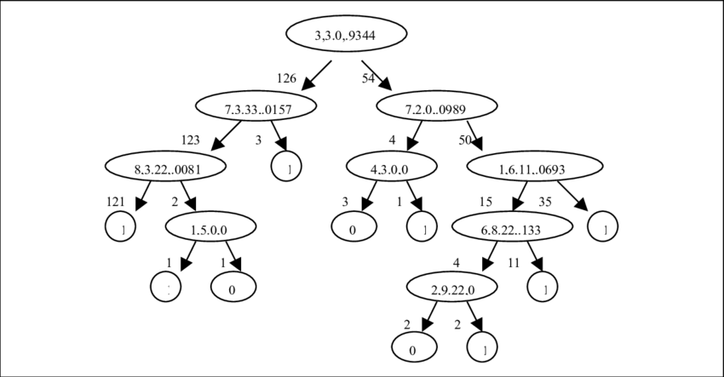
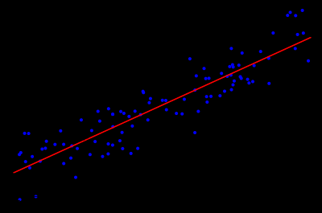
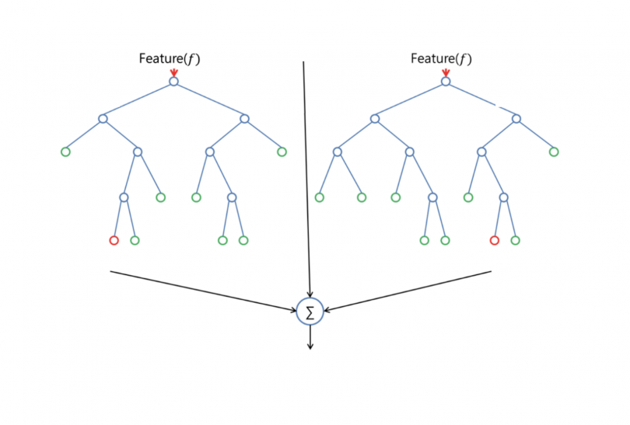
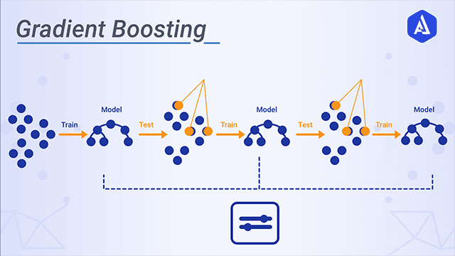
Our models
Decision tree Linear regression Random forest classifier Gradient Boosting

Slide 3
Israel - political
https://www.bbc.com/news/world-middle-east-57083595
https://edition.cnn.com/2021/05/11/middleeast/israel-gaza-violence-analysis-intl-cmd/index.html
https://www.reddit.com/r/worldnews/comments/nabees/israel_calls_on_biden_administration_to_stay_out/
https://en.wikipedia.org/wiki/Operation_Guardian_of_the_Walls
https://twitter.com/MeghUpdates/status/1392446738225504260

Slide 4
BBC | LR Prediction: Not A Fake News DT Prediction: Fake News GBC Prediction: Fake News RFC Prediction: Not A Fake News
CNN | LR Prediction: Not A Fake News DT Prediction: Fake News GBC Prediction: Fake News RFC Prediction: Not A Fake News
Reddit | LR Prediction: Fake News DT Prediction: Fake News GBC Prediction: Fake News RFC Prediction: Fake News
Wikipedia | LR Prediction: Not A Fake News DT Prediction: Fake News GBC Prediction: Fake News RFC Prediction: Not A Fake News
Twitter | LR Prediction: Fake News DT Prediction: Fake News GBC Prediction: Fake News RFC Prediction: Fake News

Slide 5
European Super League - Sport
https://www.eurosport.com/football/champions-league/2020-2021/european-super-league-uefa-begins-investigation-into-juventus-barcelona-and-real-madrid_sto8315335/story.shtml
https://edition.cnn.com/2021/04/24/football/super-league-how-it-unraveled-cmd-spt-intl/index.html
https://www.bbc.co.uk/sport/football/57036397
https://www.reddit.com/r/soccer/comments/mts09m/arsenal_supporter_trust_the_death_of_arsenal_as_a/
https://en.wikipedia.org/wiki/European_Super_League
https://www.rt.com/sport/523393-juventus-serie-a-expulsion-super-league/
https://twitter.com/FabrizioRomano/status/1390714611989729287

Slide 6
Eurosport | LR Prediction: Fake News DT Prediction: Fake News GBC Prediction: Fake News RFC Prediction: Fake News
CNN | LR Prediction: Fake News DT Prediction: Fake News GBC Prediction: Fake News RFC Prediction: Fake News
BBC | LR Prediction: Fake News DT Prediction: Fake News GBC Prediction: Fake News RFC Prediction: Fake News
Reddit | LR Prediction: Fake News DT Prediction: Fake News GBC Prediction: Fake News RFC Prediction: Fake News
Wikipedia | LR Prediction: Fake News DT Prediction: Fake News GBC Prediction: Fake News RFC Prediction: Not A Fake News
RT | LR Prediction: Fake News DT Prediction: Fake News GBC Prediction: Fake News RFC Prediction: Fake News
Twitter | LR Prediction: Fake News DT Prediction: Fake News GBC Prediction: Fake News RFC Prediction: Fake News

Slide 7
Sulawesi earthquake and tsunami - weather:neutral
https://www.bbc.co.uk/programmes/w172w60ywjfy5lz
https://en.wikipedia.org/wiki/2018_Sulawesi_earthquake_and_tsunami
https://www.cnn.com/2018/12/25/asia/indonesia-tsunami-intl/index.html
https://www.reddit.com/r/newsbotbot/comments/9juwex/ap_breaking_indonesian_media_citing_national/
https://www.rt.com/newsline/440590-indonesian-earthquake-tsunami-rescue-effort/
https://twitter.com/AndreVltchek/status/1053942251489906689

Slide 8
BBC | LR Prediction: Fake News DT Prediction: Fake News GBC Prediction: Fake News RFC Prediction: Fake News
Wikipedia | LR Prediction: Not A Fake News DT Prediction: Fake News GBC Prediction: Fake News RFC Prediction: Not A Fake News
CNN | LR Prediction: Not A Fake News DT Prediction: Not A Fake News GBC Prediction: Fake News RFC Prediction: Not A Fake News
Reddit | LR Prediction: Fake News DT Prediction: Fake News GBC Prediction: Fake News RFC Prediction: Fake News
RT | LR Prediction: Not A Fake News DT Prediction: Fake News GBC Prediction: Fake News RFC Prediction: Not A Fake News
Twitter | LR Prediction: Fake News DT Prediction: Fake News GBC Prediction: Fake News RFC Prediction: Fake News

Slide 9
Bitcoin currency - predictions, stocks
https://www.bbc.co.uk/news/technology-56508568
https://www.cnn.com/2021/05/11/investing/dogecoin-price-elon-musk-snl/index.html
https://www.reddit.com/r/Bitcoin/comments/mtc96w/sell_your_bitcoin_if_youre_going_to_be_having_a/
https://twitter.com/mrs_rebecca3/status/1392447857010122758
https://www.rt.com/business/522322-tesla-cryptocurrency-hedge-fund/
https://en.wikipedia.org/wiki/Bitcoin#2020%E2%80%93present

Slide 10
BBC | LR Prediction: Fake News DT Prediction: Fake News GBC Prediction: Fake News RFC Prediction: Fake News
CNN | LR Prediction: Fake News DT Prediction: Fake News GBC Prediction: Fake News RFC Prediction: Fake News
Reddit | LR Prediction: Fake News DT Prediction: Fake News GBC Prediction: Fake News RFC Prediction: Fake News
Twitter | LR Prediction: Fake News DT Prediction: Fake News GBC Prediction: Fake News RFC Prediction: Fake News
RT | LR Prediction: Fake News DT Prediction: Not A Fake News GBC Prediction: Not A Fake News RFC Prediction: Fake News
Wikipedia | LR Prediction: Fake News DT Prediction: Fake News GBC Prediction: Fake News RFC Prediction: Fake News

Slide 11
The Last of Us Part II - culture
https://www.bbc.co.uk/news/newsbeat-55069704
https://www.eurogamer.net/articles/2020-07-01-a-spoiler-heavy-interview-with-the-last-of-us-part-2-director-neil-druckmann
https://www.reddit.com/r/thelastofus/comments/mygq6l/visited_seattle_and_took_as_many_photos_as_i/
https://en.wikipedia.org/wiki/The_Last_of_Us_Part_II
https://stopgame.ru/newsdata/47524 - Translated from russian.

Slide 12
BBC | LR Prediction: Fake News DT Prediction: Fake News GBC Prediction: Fake News RFC Prediction: Fake News
Eurogamer.net | LR Prediction: Fake News DT Prediction: Fake News GBC Prediction: Fake News RFC Prediction: Fake News
Reddit | LR Prediction: Fake News DT Prediction: Fake News GBC Prediction: Fake News RFC Prediction: Fake News
Wikipedia | LR Prediction: Fake News DT Prediction: Fake News GBC Prediction: Fake News RFC Prediction: Fake News
Stopgame.ru | LR Prediction: Fake News DT Prediction: Fake News GBC Prediction: Fake News RFC Prediction: Fake News

Slide 13
Kazan’
https://www.bbc.co.uk/news/world-europe-57069589
https://www.cnn.com/2021/05/11/europe/russia-school-shooting-kazan-intl/index.html
https://twitter.com/VinodDX9/status/1392055110755262465
https://www.rt.com/russia/523437-kazan-school-shooting-casualties/
https://en.wikipedia.org/wiki/Kazan_school_shooting
https://www.reddit.com/r/russia/comments/n9ziwk/a_real_hero_26yearold_english_teacher_elvira/

Slide 14
BBC | LR Prediction: Fake News DT Prediction: Fake News GBC Prediction: Fake News RFC Prediction: Not A Fake News
CNN | LR Prediction: Not A Fake News DT Prediction: Fake News GBC Prediction: Fake News RFC Prediction: Not A Fake News
Twitter | LR Prediction: Fake News DT Prediction: Fake News GBC Prediction: Fake News RFC Prediction: Fake News
RT | LR Prediction: Not A Fake News DT Prediction: Fake News GBC Prediction: Fake News RFC Prediction: Not A Fake News
Wikipedia | LR Prediction: Fake News DT Prediction: Fake News GBC Prediction: Fake News RFC Prediction: Fake News
Reddit | LR Prediction: Fake News DT Prediction: Fake News GBC Prediction: Fake News RFC Prediction: Fake News

Slide 15
Confusion Matrix
 | PREDICTED TRUE | PREDICTED FALSE
ACTUAL TRUE | 7, 4, 1, 7 | 13, 16, 19, 13 | 20,20,20,20
ACTUAL FALSE | 3, 2, 0, 3 | 16, 17, 19, 16 | 19,19,19,19
 | 10, 6, 1, 10 | 29, 33, 38, 29

Slide 16
Our analysis
In this paper, we have performed a comparative analysis of 4 different algorithms.
And they revealed the following patterns:
1. All algorithms did a poor job of analyzing sports and culture news.
2. Algorithms do not respond well to short texts.
3. Algorithms poorly process texts with a large number of technical and other narrow-profile terms.
Causes of errors.
The main and most important reason for errors is the dataset.
Our dataset is composed of verified articles from the British Reuters. But it contains over 23,000 entries, most of which cover political and world news.
The second reason for errors is the properties and parameters of these algorithms. They are too simple for more accurate error detection. Usually, recurrent neural networks and neural networks with long-term memory are used for these purposes. Such networks have additional axons for memorizing the empty states of the vector.

Slide 17
COVID SARS-2
Wikipedia | LR Prediction: Fake News DT Prediction: Fake News GBC Prediction: Fake News RFC Prediction: Fake News
CNN | LR Prediction: Fake News DT Prediction: Fake News GBC Prediction: Fake News RFC Prediction: Fake News
RT | LR Prediction: Fake News DT Prediction: Fake News GBC Prediction: Fake News RFC Prediction: Fake News
Twitter | LR Prediction: Fake News DT Prediction: Fake News GBC Prediction: Fake News RFC Prediction: Fake News

Slide 18
Covid SARS-2 links
https://en.wikipedia.org/wiki/COVID-19_pandemic
https://twitter.com/maldopaco1/status/1394982732883767298
https://www.rt.com/news/524160-germany-quarantines-towers-indian-covid-variant/
https://edition.cnn.com/2021/05/19/world/coronavirus-newsletter-intl-05-19-21/index.html
https://www.bbc.com/news/world-asia-india-57154564

Slide 19
Summary of models accuracy
 | LR | DT | GBC | RFC
Political | ⅘=80% | ⅗=60% | ⅗ = 60% | ⅘ = 80% | 70%
Weather | 3/6=50% | 4/6=66.6% | 3/6 = 50% | 4/6 = 66.6% | 58.3%
Sport | 4/7=57.1% | 3/7=42.8% | 3/7 = 42.8% | 7/7 = 100% | 60.6%
Prediction | 3/6=50% | 3/6=50% | 4/6 = 66.6% | 3/6 = 50% | 54.15%
Culture | ⅗=60% | ⅗=60% | ⅖ = 40% | 2/6 = 33.3% | 48.25%
Random topic | 2/6=33.3% | ⅚=83.3% | 3/3 = 50% | 6/6 = 100% | 66.65%
COVID SARS-2 | 2/4=50% | 2/4=50% | 2/4 = 50% | 2/4 = 50% | 50%
Total | 61.48% | 58.95% | 51.34% | 68.55%

Slide 20
Our recommendations
Ways to improve models:
1. Take a more diverse dataset and include more news categories in it.
2. For each specific algorithm, increase the "computing power". For RFCs and DTs, increase the number of trees. For GBC and LR use different activation functions.

Slide 21
Links
https://drive.google.com/drive/folders/1sSHUVl6U2KUDeyrd3R9gsYNYB711eMWG?usp=sharing
https://github.com/BauyrzhanAzimkhanov/Machine-learning

